Slide 1
A Survey on Case-based Reasoning in Medicine
Nabanita Choudhury, Shahin Ara Begum

Slide 2
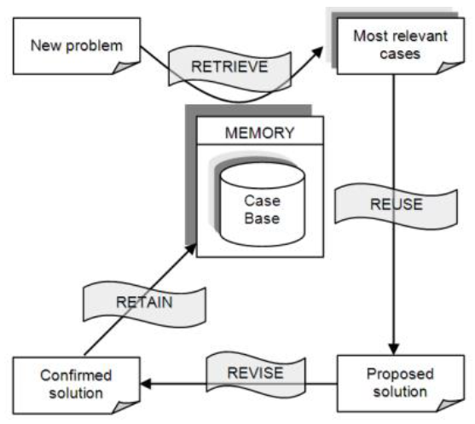
Case-based reasoning
R4 model
Retrieve
Reuse
Revise
Retain
Notes:
More like Framework rather than Algorithm
Simple case :
Retrieve – fetch a case with similar symptoms
Adaptation (Reuse & Revise) – doctor make decision based on retrieved case
Retain – save current case

Slide 3
Characteristics
Algorithms mainly focused on Retrieval
nearest neighbor retrieval, inductive approaches, knowledge guided approaches, and validated retrieval
Among the 76 systems, 51 systems completely avoid automatic adaptation

Slide 5
Adaptation Applied models
CASEY – One of the earliest model
Koton, Phyllis. “A Medical Reasoning Program That Improves with Experience.” Proceedings of the Annual Symposium on Computer Application in Medical Care (1988): 32–37.
EquiVox
Julien Henriet, Pierre-Emmanuel Leni, Rémy Laurent, Michel Salomon. Case-Based Reasoning adaptation of numerical representations of human organs by interpolation. Expert Systems with Applications, Elsevier, 2014, 41, pp.260–266. ffhal-00967441f

Slide 6
CASEY
Built around existing program “Heart Failure”
Heart Failure : diagnose by exhaustive examination of input features
CASEY :
Retrieval : most matched parameters in its case memory.
Reuse : no significant differences! -> use retrieved result
Revise : significant differences! -> use “Heart Failure”
Retain : save new case
Notes:
similar to CACHE in computer

Slide 7
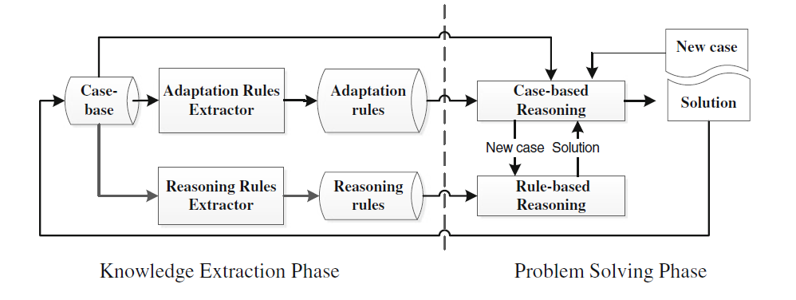
A New Hybrid Case-Based Reasoning approach for Medical Diagnosis Systems
Adaptation rules : distance fomula
Reasoning rules : reduced attr set. & reasoning rule

